Slide 1
A Medical Test
Lightboard
Bob thinks he might have a rare disease. He decides to take a test for this disease and the test comes back positive. Bob decides to read a little more about the test and discovers:
For those that have the disease, 90% will test positive (indicating the presence of the disease).
For those that do not have the disease, 80% will test negative (indicating the absence of the disease).
Should Bob be worried?

Slide 2
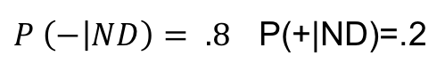
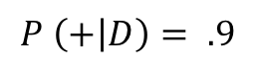
A Medical Test
Lightboard
Bob thinks he might have a rare disease. He decides to take a test for this disease and the test comes back positive. Bob decides to read a little more about the test and discovers:
For those that have the disease, 90% will test positive (indicating the presence of the disease).
For those that do not have the disease, 80% will test negative (indicating the absence of the disease).
Should Bob be worried?
$$P \left(+ | D\right)= .9$$
$P \left(− | ND\right)= .8$ P(+|ND)=.2

Slide 3
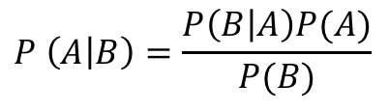
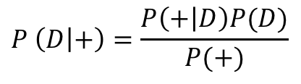
A Medical Test
Lightboard
Bob thinks he might have a rare disease. He decides to take a test for this disease and the test comes back positive. Bob decides to read a little more about the test and discovers:
For those that have the disease, 90% will test positive (indicating the presence of the disease).
For those that do not have the disease, 80% will test negative (indicating the absence of the disease).
Should Bob be worried?
What he really wants to know is the probability that he has the disease given that the tested positive. P( D | + )
$$P \left(A | B\right)=\frac{P\left(B | A\right)P(A)}{P(B)}$$
$$P \left(D | +\right)=\frac{P\left(+ | D\right)P(D)}{P(+)}$$
We need more information!

Slide 4
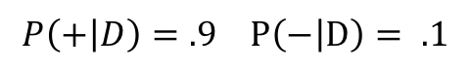
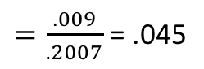
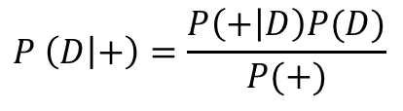
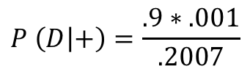
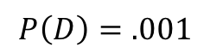
A Medical Test
Lightboard
Bob thinks he might have a rare disease. He decides to take a test for this disease and the test comes back positive. Bob decides to read a little more about the test and discovers:
For those that have the disease, 90% will test positive (indicating the presence of the disease).
For those that do not have the disease, 80% will test negative (indicating the absence of the disease).
Should Bob be worried?
What he really wants to know is the probability that he has the disease given that the tested positive. P( D | + )
$$P \left(D | +\right)=\frac{P\left(+ | D\right)P(D)}{P(+)}$$
$$P\left(+ | D\right)=.9 P\left(− | D\right)= .1$$
$$P\left(D\right)=.001$$
$$P\left(+\right)=P\left(+ | D\right)∗P\left(D\right)+P\left(+ | ND\right)∗P\left(ND\right)=.9∗.001+.2∗.999= .2007$$
$$P \left(D | +\right)=\frac{.9∗.001}{.2007}$$
$=\frac{.009}{.2007}$ = .045

Slide 6
Example: Play Volleyball Today?

Slide 7
Example: Volleyball
Outlook | Wind | Volleyball
Sunny | Low | Yes
Sunny | Hi | No
Sunny | Hi | Yes
Cloudy | Low | Yes
Cloudy | Low | No
Cloudy | Low | Yes
Cloudy | Hi | Yes
Rain | Hi | No
Rain | Hi | No
Rain | Low | Yes
What is the probability that if it is Sunny and the Wind is High that Sammy will play volleyball?

Slide 8
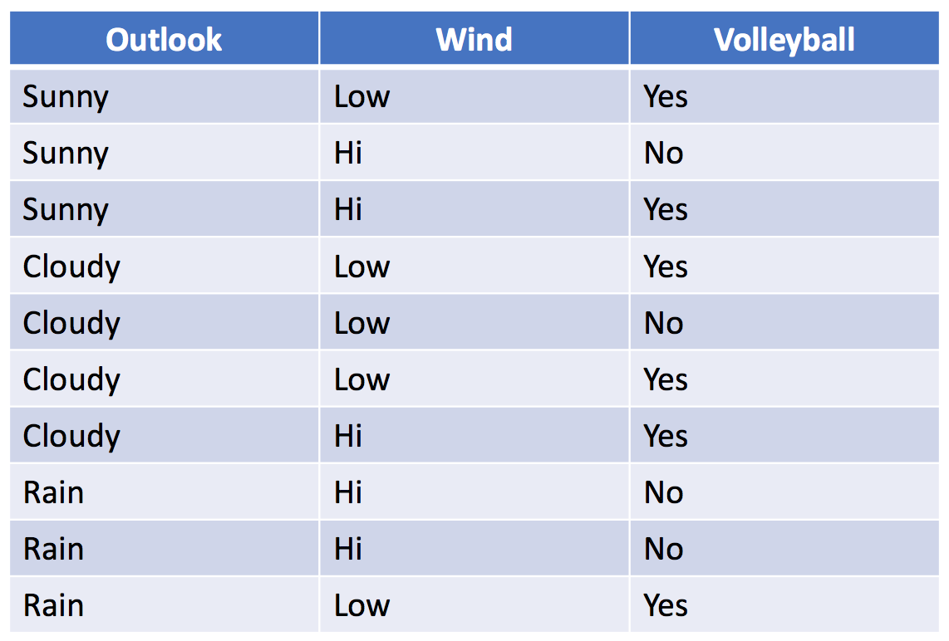
Example: Volleyball
The Naïve in Naïve Bayes means that we are
assuming that the explanatory variables are
conditionally independent.
P(Outlook and Wind | Vball)
= P(Outlook | Vball ) * P(Wind | vball)
What is the probability that if it is Sunny and the Wind is High that he will play volleyball?
If we just look at the table, we might say 50% since we only observed two days that were Sunny and High wind and Sammy only played on one of those days.
But we have 8 more observations and of the 3 Sunny days Sammy played on 66% of them and on the 5 highly windy days Sammy only played on 40% of them.
We are basing our estimate on only two observations. Let’s use all the information!

Slide 9
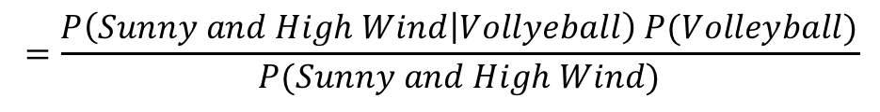
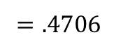
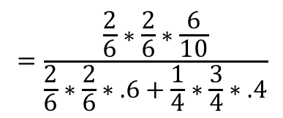
Example: Volleyball
The “Naïve” in Naïve Bayes means that we are
assuming that the explanatory variables are
conditionally independent:
P(Outlook and Wind | Vball)
= P(Outlook | Vball ) * P(Wind | vball)
What is the probability that if it is Sunny and the Wind is High that we will play volleyball?
$$P \left(Volleyball | Outlook=Sunny and Wind=High\right)$$
$$=\frac{P\left(Sunny and High Wind | Vollyeball\right) P(Volleyball)}{P(Sunny and High Wind)}$$
$$=\frac{P\left(Sunny | Vollyeball\right)P\left(High Wind | Vollyeball\right)P(Volleyball)}{P\left(Sunny|Vball\right)P(HighWind|Vball)P\left(Vball\right)+P\left(Sunny|No Vball\right)P(HighWind|No Vball)P\left(No Vball\right)}$$
$$=\frac{\frac{2}{6}∗\frac{2}{6}∗\frac{6}{10}}{\frac{2}{6}∗\frac{2}{6}∗.6+\frac{1}{4}∗\frac{3}{4}∗.4}$$
$$=.4706$$

Slide 10
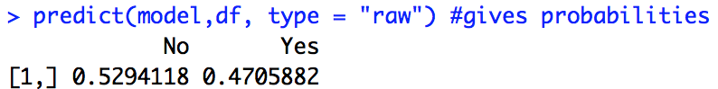
Example: Volleyball with naiveBayes()
# Unit 9 Naive Bayes Classifier
vball = read.csv(file.choose(),header = TRUE)
vball
install.packages("e1071") #naiveBayes()
library(e1071)
model = naiveBayes(Volleyball~.,data = vball)
df = data.frame(Outlook = ”Sunny", Wind = "Hi")
predict(model,df) #just classifications
predict(model,df, type = "raw") #gives probabilities
The posterior probability associated with playing volleyball on a Sunny and highly windy day is .4706 which is less than the posterior probability of not playing volleyball in the same conditions. For this reason we will predict that Sammy will not play volleyball on this day ... although we are not extremely confident in this prediction.

Slide 12
Small Example

Slide 13
Example: NYT Article Classification
Article | Label | Snippet
1 | N | The crime was in Central Park
2 | O | What do you think about crime?
3 | N | the crime in Central Park is
4 | N | the jogger was last seen
5 | O | One mans thoughts on the central
The crime was in Central Park
$P\left(N | W\right)=\frac{P(W|N)P(N)}{P(W)}= \frac{\left(1\right)(.6)}{(.8)}.\frac{\left(.66\right)(.6)}{(.6)}.\frac{\left(.66\right)(.6)}{(.4)}\text{.}$ $\frac{\left(.66\right)(.6)}{(.4)}$ . $\frac{ ()()}{()} . \frac{() ()}{()}$
$P\left(O | W\right)=\frac{P(W|O)P(O)}{P(W)}= \frac{\left(.5\right)(.4)}{(.8)}.\frac{\left(.5\right)(.4)}{(.6)}.\frac{\left(0\right)(.4)}{(.4)}\text{.}$ $\frac{\left(0\right)(.4)}{(.4)}$ . $\frac{() ()}{()}. \frac{() ()}{()}$

Slide 14
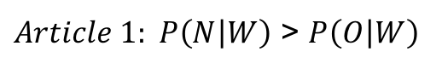
Example: NYT Article Classification
Article | Label | Snippet
1 | N | The crime was in Central Park
2 | O | What do you think about crime?
3 | N | the crime in Central Park is
4 | N | the jogger was last seen
5 | O | One mans thoughts on the central
The crime was in Central Park
$P\left(N | W\right)=\frac{P(W|N)P(N)}{P(W)}= \frac{\left(1\right)(.6)}{(.8)}.\frac{\left(.66\right)(.6)}{(.6)}.\frac{\left(.66\right)(.6)}{(.4)}\text{.}$ $\frac{\left(.66\right)(.6)}{(.4)}$ . $\frac{\left(.66\right)(.6)}{(.6)} .\frac{\left(.66\right)(.6)}{(.4)}$
$P\left(O | W\right)=\frac{P(W|O)P(O)}{P(W)}= \frac{\left(.5\right)(.4)}{(.8)}.\frac{\left(.5\right)(.4)}{(.6)}.\frac{\left(0\right)(.4)}{(.4)}\text{.}$ $\frac{\left(0\right)(.4)}{(.4)}$ . $\frac{\left(.5\right)(.4)}{(.6)} . \frac{\left(0\right)(.4)}{(.4)}$
Classify as
NEWS!
$Article 1: P\left(N | W\right)$ > $P\left(O | W\right)$

Slide 16
Example: New York Times Article Classification
In depth and in R

Slide 17
Example: NYT Article Classification
# Sample R Code for Dealing with the NYT API
```{r}
library(dplyr)
library(tidyr)
library(plyr)
library(jsonlite)
NYTIMES_KEY = "OG89fUubcS8FXofVrLA4dmIOHh5omiFa" #Your Key Here … get from NTY API website
# Let's set some parameters
term <- "central+park+jogger" # Need to use + to string together separate words
begin_date <- "19890419"
end_date <- "19910901"
baseurl <- paste0("http://api.nytimes.com/svc/search/v2/articlesearch.json?q=",term,
"&begin_date=",begin_date,"&end_date=",end_date,
"&facet_filter=true&api-key=",NYTIMES_KEY, sep="")
initialQuery <- jsonlite::fromJSON(baseurl)
maxPages <- round((initialQuery$response$meta$hits[1] / 10)-1)
pages <- list()
for(i in 0:maxPages){
nytSearch <- jsonlite::fromJSON(paste0(baseurl, "&page=", i), flatten = TRUE) %>% data.frame()
message("Retrieving page ", i)
pages[[i+1]] <- nytSearch
Sys.sleep(5) #iyou may get an error if you grab the data too fast … so we create a delay between pages.
}
#Combine all results
allNYTSearch <- rbind_pages(pages)

Slide 18
Example: NYT Article Classification
# Visualize coverage by section
allNYTSearch %>%
group_by(response.docs.type_of_material) %>%
dplyr::summarize(count=n()) %>%
mutate(percent = (count / sum(count))*100) %>%
ggplot() +
geom_bar(aes(y=percent, x=response.docs.type_of_material, fill=response.docs.type_of_material), stat = "identity") + coord_flip()
#Make another column of News versus Other ... The labels
allNYTSearch$NewsOrOther = ifelse(allNYTSearch$response.docs.type_of_material == "News","News","Other")
# Visualize coverage of News or Other
allNYTSearch %>%
group_by(NewsOrOther) %>%
dplyr::summarize(count=n()) %>%
mutate(percent = (count / sum(count))*100) %>%
ggplot() +
geom_bar(aes(y=percent, x=NewsOrOther, fill=NewsOrOther), stat = "identity") + coord_flip()

Slide 19
Example: NYT Article Classification
#This function returns P(News | Keyword)
#P(News|KW) = P(KW|News)* P(News) / P(KW)
Pnews_word = function(key_word = "jogging", trainingSet, alphaLaplace = .1, betaLaplace = .2) # alpha and beta are for laplace smoothing
{
#Take out all but alpha numeric characters from training headlines
trainingSet$response.docs.headline.main = unlist(gsub("[^[:alnum:] ]", "", trainingSet$response.docs.headline.main))
NewsGroup = trainingSet[trainingSet$NewsOrOther == "News",]
OtherGroup = trainingSet[trainingSet$NewsOrOther == "Other",]
pNews = dim(NewsGroup)[1] / (dim(NewsGroup)[1] + dim(OtherGroup)[1])
pOther = 1 - pNews
pKWGivenNews = (length(grep(paste("\\b",key_word,"\\b",sep=""),NewsGroup$response.docs.headline.main,ignore.case = TRUE))+alphaLaplace)/(dim(NewsGroup)[1]+betaLaplace)
pKWGivenOther = (length(grep(paste("\\b",key_word,"\\b",sep=""),OtherGroup$response.docs.headline.main,ignore.case = TRUE))+alphaLaplace)/(dim(OtherGroup)[1]+betaLaplace)
pKW = length(grep(paste("\\b",key_word,"\\b",sep=""),trainingSet$response.docs.headline.main,ignore.case = TRUE))/dim(trainingSet)[1]
pNewsGivenKW = pKWGivenNews*pNews/pKW
pOtherGivenKW = pKWGivenOther*pOther/pKW
return(pNewsGivenKW)
}

Slide 20
Example: NYT Article Classification
theScoreHolderNews = c()
theScoreHolderOther = c()
articleScoreNews = 0;
articleScoreOther = 0;
for (i in 1 : dim(allNYTSearchTest)[1]) #This loop iterates over the articles in the Test Set
{
articleScoreNews = 1;
articleScoreOther = 1;
#strsplit(gsub("[^[:alnum:] ]", "", str), " +")
#strsplit(allNYTSearch$response.docs.headline.main[i],split = " ")
#Take out all but alpha numeric characters from search string
theText = unlist(strsplit(gsub("[^[:alnum:] ]", "", allNYTSearchTest$response.docs.headline.main[i]), " +"))
for(j in 1 : length(theText)) #This loop iterates over the headline (each word)
{
articleScoreNews = articleScoreNews * Pnews_word(theText[j],allNYTSearchTrain)
articleScoreOther = articleScoreOther * (1 - Pnews_word(theText[j],allNYTSearchTrain))
}
theScoreHolderNews[i] = articleScoreNews
theScoreHolderOther[i] = articleScoreOther
}
# Classify the article as News or Other based on a given piece of information from the article.
allNYTSearchTest$Classified = ifelse(theScoreHolderNews > theScoreHolderOther,"News","Other")
#Confusion Matrix
table(allNYTSearchTest$Classified,allNYTSearchTest$NewsOrOther) #Actual in Columns

Slide 22
Naïve Bayes with Continuous Predictors

Slide 23
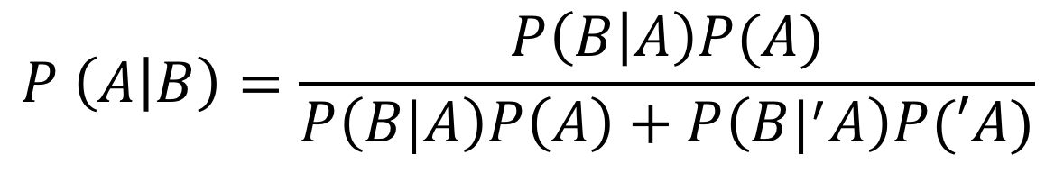
Continuous Predictors
What if B is a continuous rather than categorical variable?
$$P \left(A | B\right)=\frac{P\left(B | A\right)P(A)}{P\left(B|A\right)P\left(A\right)+P\left(B|^{′}A\right)P(′A)}$$
We will assume that B is normally distributed …
P(A) and P(‘A) are calculated with frequencies since A is categorical.
x = seq(-5,5,.01)
y = dnorm(x,2,.5)
df = data.frame(x = x, y = y)
df %>% ggplot(aes(x = x, y = y)) + geom_line() + xlab("B") + ylab("Probability Density") + ggtitle("Probability Density of B given 'A")

Slide 24
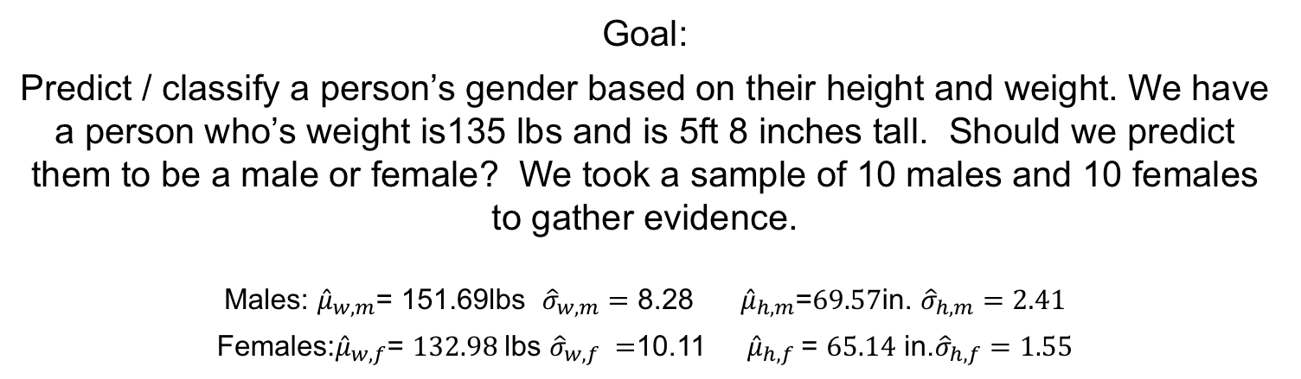
Example: Classifying Gender Based on Height and Weight.
Goal:
Predict / classify a person’s gender based on their height and weight. We have a person who’s weight is135 lbs and is 5ft 8 inches tall. Should we predict them to be a male or female? We took a sample of 10 males and 10 females to gather evidence.
Males: ${\hat{μ}}_{w,m}$= 151.69lbs ${\hat{σ}}_{w,m}=$ 8.28 ${\hat{μ}}_{h,m}\text{=}69.57\text{in}\text{. }{\hat{σ}}_{h,m}=2.41$
Females:${\hat{μ}}_{w,f}$= $132.98$lbs ${\hat{σ}}_{w,f} =$10.11 ${\hat{μ}}_{h,f}$= $65.14$ in.${\hat{σ}}_{h,f}=1.55$
set.seed(34)
males = rmvnorm(10,mean = c(70,150), sigma = matrix(c(9,0,0,100),ncol = 2))
females = rmvnorm(10,mean = c(66,130), sigma = matrix(c(4,0,0,81),ncol = 2))
dfMF = data.frame(height = c(males[,1],females[,1]), weight = c(males[,2],females[,2]), MorF = c(rep("M",10),rep("F",10)))
dfMF %>% ggplot(aes(x = height, y = weight, color = MorF)) + geom_point()
dfMF %>% ggplot(aes(x = height, y = weight, color = MorF)) + geom_point() + stat_ellipse(level = c(.95)) + stat_ellipse(level = .90) + stat_ellipse(level = .70) + stat_ellipse(level = .40) + stat_ellipse(level = .10)

Slide 25
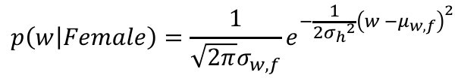
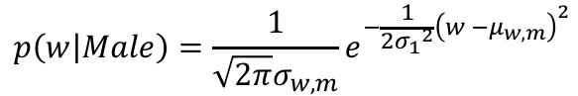
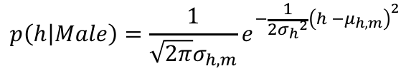
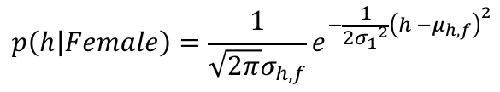
Example: Classifying Gender Based on Height and Weight.
$$p\left(w | Male\right)=\frac{1}{\sqrt{2π}σ_{w,m}}e^{−\frac{1}{2{σ_{1}}^{2}}{\left(w −μ_{w,m}\right)}^{2}}$$
$$p\left(h | Male\right)=\frac{1}{\sqrt{2π}σ_{h,m}}e^{−\frac{1}{2{σ_{h}}^{2}}{\left(h −μ_{h,m}\right)}^{2}}$$
$$p\left(w | Female\right)=\frac{1}{\sqrt{2π}σ_{w,f}}e^{−\frac{1}{2{σ_{h}}^{2}}{\left(w −μ_{w,f}\right)}^{2}}$$
$$p\left(h | Female\right)=\frac{1}{\sqrt{2π}σ_{h,f}}e^{−\frac{1}{2{σ_{1}}^{2}}{\left(h −μ_{h,f}\right)}^{2}}$$
x = seq(50,90,.1)
y = dnorm(x,66,2)
df = data.frame(x = x, y = y)
df %>% ggplot(aes(x = x, y = y)) + geom_line() + xlab("B") + ylab("Probability Density") + ggtitle("Probability Density of Height of Women")
x = seq(50,90,.1)
y = dnorm(x,70,3)
df = data.frame(x = x, y = y)
df %>% ggplot(aes(x = x, y = y)) + geom_line() + xlab("B") + ylab("Probability Density") + ggtitle("Probability Density of Height of Men")
x = seq(100,180,.1)
y = dnorm(x,130,9)
df = data.frame(x = x, y = y)
df %>% ggplot(aes(x = x, y = y)) + geom_line() + xlab("B") + ylab("Probability Density") + ggtitle("Probability Density of Weight of Women")
x = seq(100,180,.1)
y = dnorm(x,150,10)
df = data.frame(x = x, y = y)
df %>% ggplot(aes(x = x, y = y)) + geom_line() + xlab("B") + ylab("Probability Density") + ggtitle("Probability Density of Weight of Women")

Slide 26
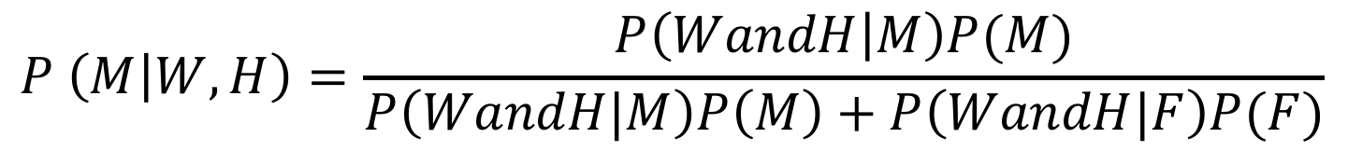
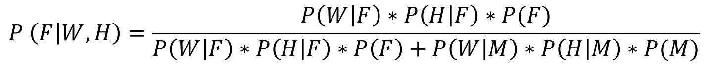
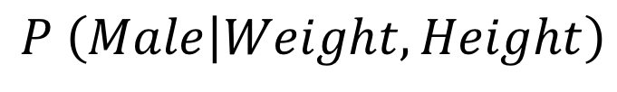
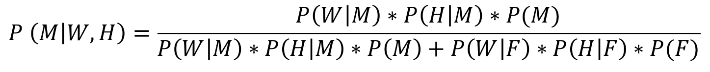
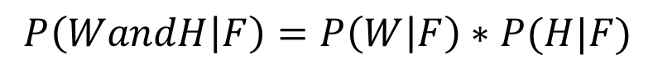
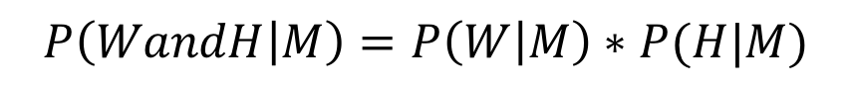
Example: Classifying Gender Based on Height and Weight.
$$P \left(Male | Weight, Height\right)$$
$$P \left(M | W, H\right)=\frac{P\left(WandH | M\right)P(M)}{P\left(WandH|M\right)P\left(M\right)+P\left(WandH|F\right)P(F)}$$
Naïve part of the Naïve Bayes Assumption
Strong assumption that is very likely violated in this example!
$$P\left(WandH | M\right)=P\left(W | M\right)∗P(H|M)$$
$$P\left(WandH | F\right)=P\left(W | F\right)∗P(H|F)$$
$$P \left(M | W, H\right)=\frac{P\left(W | M\right)∗P\left(H | M\right)∗P(M)}{P\left(W | M\right)∗P\left(H | M\right)∗P\left(M\right)+P\left(W | F\right)∗P\left(H | F\right)∗P(F)}$$
$$P \left(F | W, H\right)=\frac{P\left(W | F\right)∗P\left(H | F\right)∗P(F)}{P\left(W | F\right)∗P\left(H | F\right)∗P\left(F\right)+P\left(W | M\right)∗P\left(H | M\right)∗P(M)}$$

Slide 27
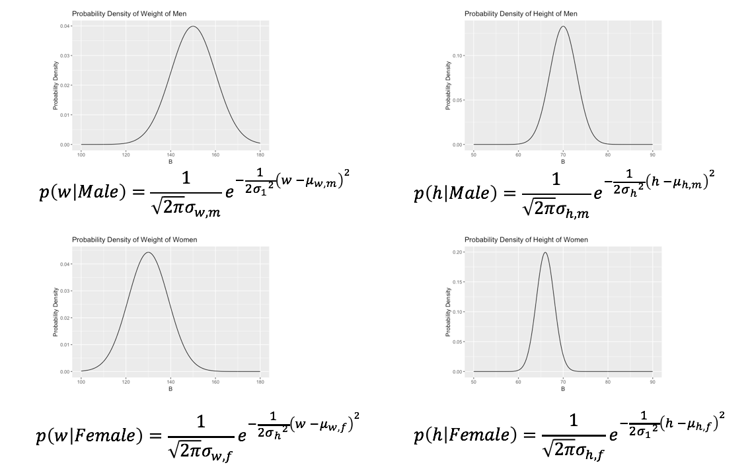
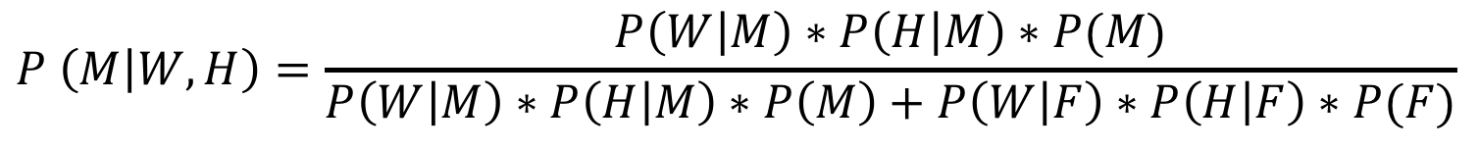
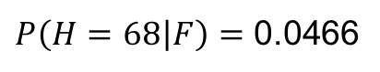
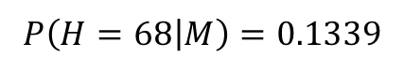
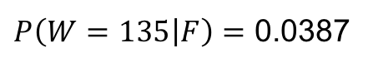
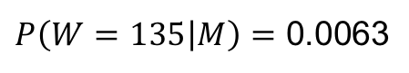
Example: Classifying Gender Based on Height and Weight.
$$P \left(M | W, H\right)=\frac{P\left(W | M\right)∗P\left(H | M\right)∗P(M)}{P\left(W | M\right)∗P\left(H | M\right)∗P\left(M\right)+P\left(W | F\right)∗P\left(H | F\right)∗P(F)}$$
Again, we sampled 10 men and 10 women therefore P(M) = .5 and P(F) = .5
These are the prior probabilities of M and F.
For a person with weight = 135lbs and
height = 68 inches:
$P\left(W=135 | M\right)=$ 0.0063
$P\left(W=135 | F\right)=$ 0.0387
$$P\left(H=68 | M\right)=0.1339$$
$P\left(H=68 | F\right)=$ 0.0466
set.seed(34)
males = rmvnorm(10,mean = c(70,150), sigma = matrix(c(9,0,0,100),ncol = 2))
females = rmvnorm(10,mean = c(66,130), sigma = matrix(c(4,0,0,81),ncol = 2))
dfMF = data.frame(height = c(males[,1],females[,1]), weight = c(males[,2],females[,2]), MorF = c(rep("M",10),rep("F",10)))
dfMF %>% ggplot(aes(x = height, y = weight, color = MorF)) + geom_point() + stat_ellipse(level = c(.95)) + stat_ellipse(level = .90) + stat_ellipse(level = .70) + stat_ellipse(level = .40) + stat_ellipse(level = .10)

Slide 28
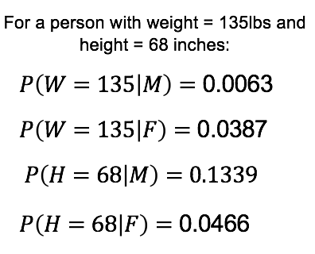
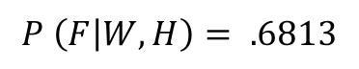
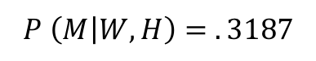
Example: Classifying Gender Based on Height and Weight.
$$P \left(M | W, H\right)=\frac{P\left(W | M\right)∗P\left(H | M\right)∗P(M)}{P\left(W | M\right)∗P\left(H | M\right)∗P\left(M\right)+P\left(W | F\right)∗P\left(H | F\right)∗P(F)}$$
$$P \left(M | W, H\right)=\frac{.0063∗.1339∗0.5}{.0063∗.1339∗0.5+.0387∗.0466∗0.5}$$
$$P \left(M | W, H\right)= . 3187$$
$$P \left(F | W, H\right)=\frac{.0387∗.0466∗0.5}{.0387∗.0466∗0.5+.0063∗.1339∗0.5}$$
$$P \left(F | W, H\right)= .6813$$
#get sample means and sds from sample to use in calculations
#rows 1-10 are male and 11-20 are female
# column 1 is height and column 2 is weight and column 3 is male/female factor
mean(dfMF[1:10,1])
mean(dfMF[11:20,1])
mean(dfMF[1:10,2])
mean(dfMF[11:20,2])
sd(dfMF[1:10,1])
sd(dfMF[11:20,1])
sd(dfMF[1:10,2])
sd(dfMF[11:20,2])
dnorm(68,69.57463,2.405437)
#Exact calculation … rounded in the slide above… this will match naiveBayes() call.
dnorm(68,69.57463,2.405437)*dnorm(135,151.6851,8.276395)*.5/(dnorm(68,69.57463,2.405437)*dnorm(135,151.6851,8.276395)*.5 + dnorm(68,65.13555,1.548547)*dnorm(135,132.9786,10.11479)*.5)

Slide 30
NB with Continuous Predictors and R | package e1071

Slide 31
Example: Classifying Gender Based on Height and Weight.
#get sample means and sds from sample to use in calculations
#rows 1-10 are male and 11-20 are female
# column 1 is height and column 2 is weight and column 3 is male/female factor
mean(dfMF[1:10,1])
mean(dfMF[11:20,1])
mean(dfMF[1:10,2])
mean(dfMF[11:20,2])
sd(dfMF[1:10,1])
sd(dfMF[11:20,1])
sd(dfMF[1:10,2])
sd(dfMF[11:20,2])
#Cacluate f(h = 68 | M)
dnorm(68,69.57463,2.405437)
#Exact calculation: P(M|W and H)… rounded in the slide above… this will match naiveBayes() call.
dnorm(68,69.57463,2.405437)*dnorm(135,151.6851,8.276395)*.5/(dnorm(68,69.57463,2.405437)*dnorm(135,151.6851,8.276395)*.5 + dnorm(68,65.13555,1.548547)*dnorm(135,132.9786,10.11479)*.5)
#naiveBayes() from e1071 package
dff = data.frame(height = 68, weight = 135)
m <- naiveBayes(MorF ~ ., data = dfMF)
#or
#m = naiveBayes(dfMF[,c(1,2)],dfMF[,3])
predict(m,dff, type = "raw")

Slide 32
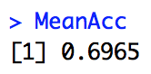
Example: Versicolor v. Virginica
# Loop for average of many training / test partition
irisVersVirg = iris %>% filter(Species == "versicolor" | Species == "virginica")
irisVersVirg = droplevels(irisVersVirg,exclude = "setosa")
summary(irisVersVirg)
iterations = 100
masterAcc = matrix(nrow = iterations)
splitPerc = .8 #Training / Test split Percentage
for(j in 1:iterations)
{
trainIndices = sample(1:dim(irisVersVirg)[1],round(splitPerc * dim(irisVersVirg)[1]))
train = irisVersVirg[trainIndices,]
test = irisVersVirg[-trainIndices,]
model = naiveBayes(train[,c(1,2)],train$Species)
table(test$Species,predict(model,test[,c(1,2)]))
CM = confusionMatrix(table(test$Species,predict(model,test[,c(1,2)])))
masterAcc[j] = CM$overall[1]
}
MeanAcc = colMeans(masterAcc)
MeanAcc

Slide 33
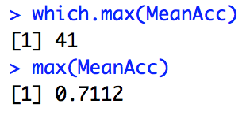
Example: Versicolor v. Virginica
# Loop for many k and the average of many training / test partition
set.seed(1)
splitPerc = .8
iterations = 500
numks = 60
masterAcc = matrix(nrow = iterations, ncol = numks)
for(j in 1:iterations)
{
accs = data.frame(accuracy = numeric(60), k = numeric(60))
trainIndices = sample(1:dim(irisVersVirg)[1],round(splitPerc * dim(irisVersVirg)[1]))
train = irisVersVirg[trainIndices,]
test = irisVersVirg[-trainIndices,]
for(i in 1:numks)
{
classifications = knn(train[,c(1,2)],test[,c(1,2)],train$Species, prob = TRUE, k = i)
table(test$Species,classifications)
CM = confusionMatrix(table(test$Species,classifications))
masterAcc[j,i] = CM$overall[1]
}
}
MeanAcc = colMeans(masterAcc)
plot(seq(1,numks,1),MeanAcc, type = "l")
which.max(MeanAcc)
max(MeanAcc)

Slide 35
Example | Iris Data and NB with Multinomial Responses

Slide 36
Example: Iris Data
iris %>% ggplot(aes(x = Sepal.Length,Sepal.Width,color = Species)) + geom_point()

Slide 37
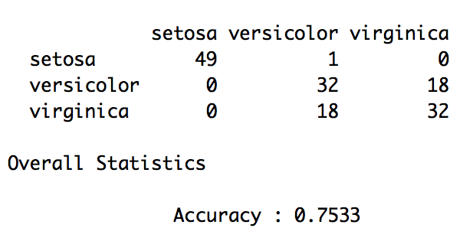
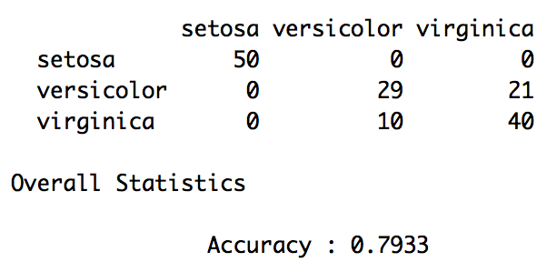
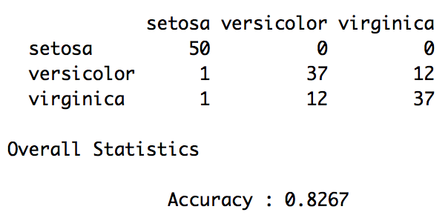
Example: Iris Data | Evaluation
#Leave 1 out CV
confusionMatrix(table(iris[,5],knn.cv(iris[,c(1,2)],iris[,5],k = 3)))
confusionMatrix(table(iris[,5],knn.cv(iris[,c(1,2)],iris[,5],k = 20)))
confusionMatrix(table(iris[,5],knn.cv(iris[,c(1,2)],iris[,5],k = 50)))

